Slide 1



AI Hacks Datathon Workshop December, 2020
Presented by AI@Penn

Slide 2
Quick Note
Stay Notified About:
Educational workshops about machine learning and artificial intelligence
Guest speakers from a wide range of industries and companies
Events (more cool AI@Penn datathons???)
https://forms.gle/PsBLF5cApFisAv4g8
Notes:
Presenters should drop link in Zoom chat

Slide 3
Today’s Plan
Learn about the Three Types of Recommender Systems
Explore Real-World Applications of Recommender Systems
Program R.S. in Google Collab to Give Movie Recommendations
Discuss the Structure and Objective of Recommender Systems

Slide 4
What are Recommender Systems?
Optimization
Model performance is very subjective compared to other types of machine learning algorithms
Metric of evaluation is chosen on a project-by-project basis
Minutes of retention (YouTube)
Amount spent (Amazon)
# of paid subscribers (Netflix)
RS is trained on current user preferences
RS makes content recommendations to users
Users will each enjoy the content at varying levels
Model performance is recorded and analyzed
Users preferences are updated based on new data
Inputs:
Database of content
Population of users
Outputs:
Match the most effective content with each user
Model certainty (similarity score)
Maximize a metric of evaluation

Slide 5



Types of Recommender Systems
Popularity-based
Content-based
Collaborative Filtering
Notes:
Michael Starts Here

Slide 6

Popularity-Based R.S.
The simplest recommender system to build
The "Trending" List you see on Netflix / YouTube
Keeps track of views/purchases over a time interval and then displays content in descending order. Simple, yet effective
Good idea to differentiate popularity lists based off of factors like location
Pros: Easy to Build and Effective
Cons: Not personalized

Slide 7
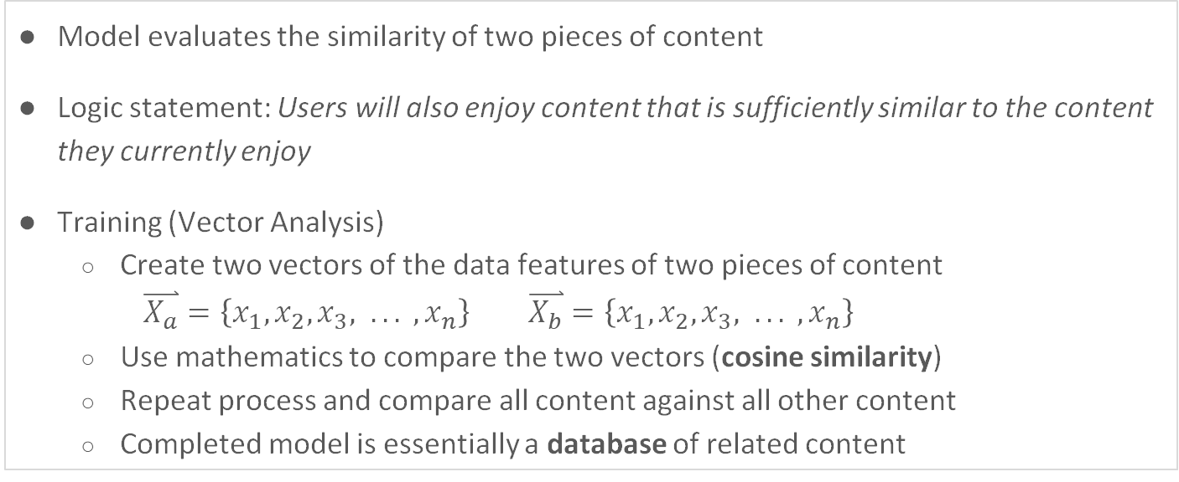
Content-based R.S.
Model evaluates the similarity of two pieces of content
Logic statement: Users will also enjoy content that is sufficiently similar to the content they currently enjoy
Training (Vector Analysis)
Create two vectors of the data features of two pieces of content
$\overset{⃑}{X_{a}}=\left\{x_{1}, x_{2}, x_{3}, .. . , x_{n}\right\}$ $\overset{⃑}{X_{b}}=\left\{x_{1}, x_{2}, x_{3}, .. . , x_{n}\right\}$
Use mathematics to compare the two vectors (cosine similarity)
Repeat process and compare all content against all other content
Completed model is essentially a database of related content

Slide 8
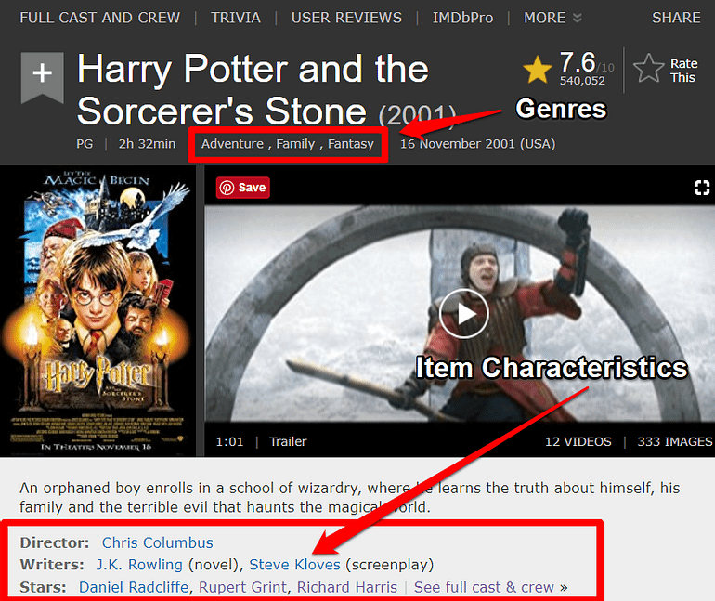

Content-based R.S.
Recommendation Pipeline
Input a list of content pulled from user (watch list, search history, cart)
Model returns a list of unseen content
User is shown a list of “Items similar to…” “You might like…”

Slide 9

Collaborative Filtering System
Systems find similar users based on their activities and preferences
For two similar users A and B, if A has purchased / viewed content B hasn't, that content gets recommended and vice-versa
Pros:
Don't need as much metadata about the products
Needs more data about user interactions
Incredibly effective recommendation system
Cons:
Tougher to "explain" the recommendation
Tends to hold a bias towards more popular items
"Cold-Start" - Difficult to make recommendations initially

Slide 10
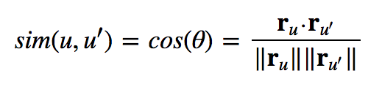
CF System Implementation I
Based on low-dimensional models revolving around matrix factorization
Memory-Based CF can be divided into two types:
User-Item filtering – takes a given users, finds similar users, and recommends items that those similar users liked
Item-Item filtering – takes an item, find users who liked that item, and finds other items that those users or similar users also liked
Not learning any parameters using gradient descent
Instead, we calculate similarity with Cosine similarity or Pearson Correlation Coefficients
Cosine similarity: Cosine of the angle between two vectors

Slide 11
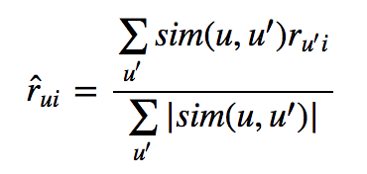
CF System Implementation II
After computing similarities, use the weighted normalized sum to predict user u's ratings for a movie
Pro: No training or optimization is involved
Con: Sparse data hinders scalability of this approach
For the example we have here (movie recommendation), our data is really sparse
Python libraries like fast.ai has libraries for Probabilistic Matrix Factorization

Slide 12
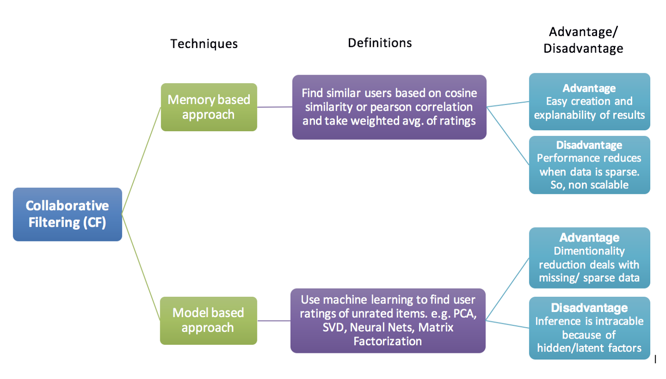
CF System Implementation III
Memory-based:
User-Item filtering
Item-Item filtering
Model-based:
Predict user's rating of unrated items
Support Vector Machine, Decision tree
Clustering-based:
K-Nearest-Neighbors -> Non-parametric approach
For KNN, we limit number of similar users as k, which makes system more scalable

Slide 13
CF System Implementation IV
Deep Learning approach – multi-layered Neural Nets
Create embeddings that represent categorical variables as continuous vectors. NN embeddings are low-dimensional and learned
Embeddings are used to find nearest neighbors, visualization in low dimensions, and can be inputs to an ML model
Can be implemented with the Keras framework in Python (we won't be doing this)
Recommendation Pipeline
Preprocessed Input
Embedding
Dot Products Between Embeddings
Reshaping of Dot Products
Activation Output

Slide 14

Amazon Personalize (AWS)
Allows you to train / deploy / update recommender system in real time
Reasonable pricing depending on project scope
https://aws.amazon.com/personalize/

Slide 15
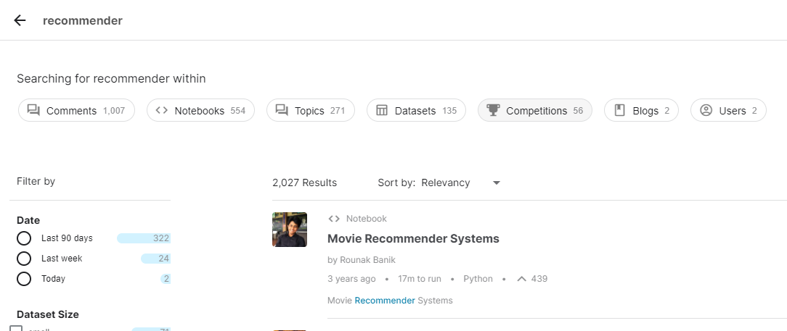
Additional Resources
Kaggle Competitions: https://www.kaggle.com/search?q=recommender
Towards Data Science: https://towardsdatascience.com/search?q=recommender/
Medium: https://medium.com/search?q=recommender

Slide 16
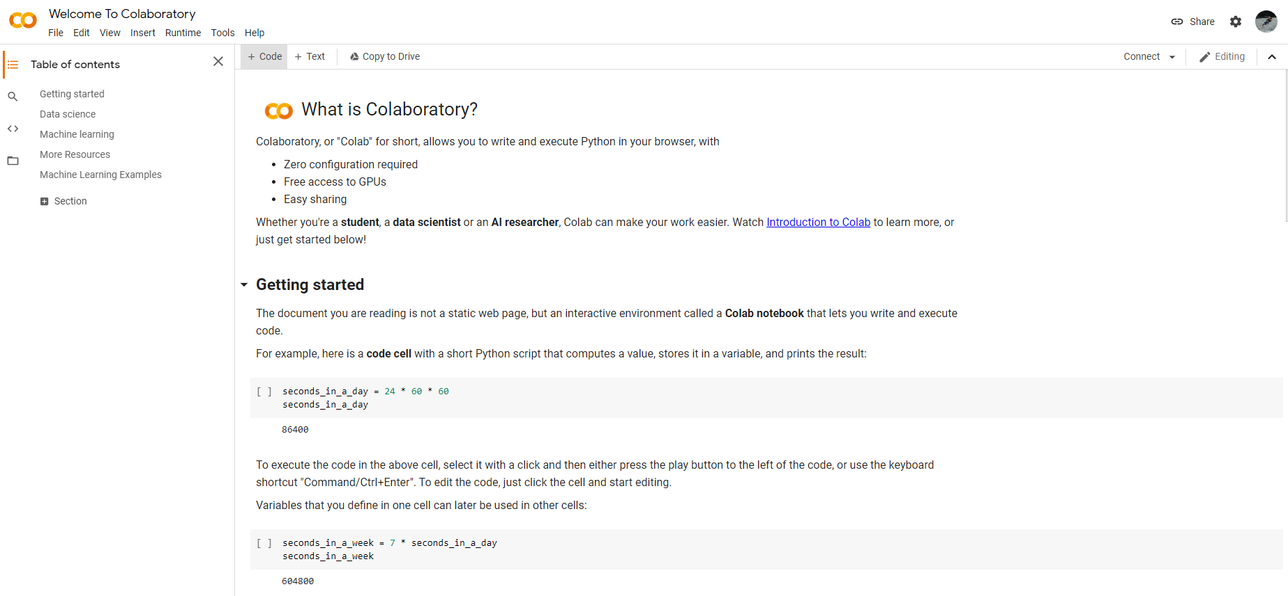
Programming Environment
Google Collab: https://colab.research.google.com/
New Python 3 notebook
Allows for note-taking
Efficient running of programs
In-built libraries

Slide 17
Next steps: https://github.com/kjaisingh/AI-Penn

Slide 18
What are Recommender Systems?
Optimization
Model performance is very subjective compared to other types of machine learning algorithms
Metric of evaluation is chosen on a project-by-project basis
Minutes of retention (YouTube)
Amount spent (Amazon)
# of paid subscribers (Netflix)
RS is trained on current user preferences
RS makes content recommendations to users
Users will each enjoy the content at varying levels
Model performance is recorded and analyzed
Users preferences are updated based on new data

